Slide 1
Sugarcane crop and soil analysis
Group 08
Jigar Mangukiya – s3715807
Vishwa Gandhi – s3714805
Vikas Virani – s3715555
Salina Bharthu – s3736867
Ria Talwar – s3729618
Sarthak Sirari – s3766477

Slide 2
MOTIVATION
Presented by - Jigar
Acquiring new land for sugarcane farming requires soil study to measure nutrient levels in the soil
It is costly, resource consuming & often inaccurate in nature.
Soil Suitability
Evaluation
Planning for Finances, Insurance, Work force & Logistic requires some estimation about yield
Traditional approaches can be supported with more statistical approach
Yield Prediction

Slide 3
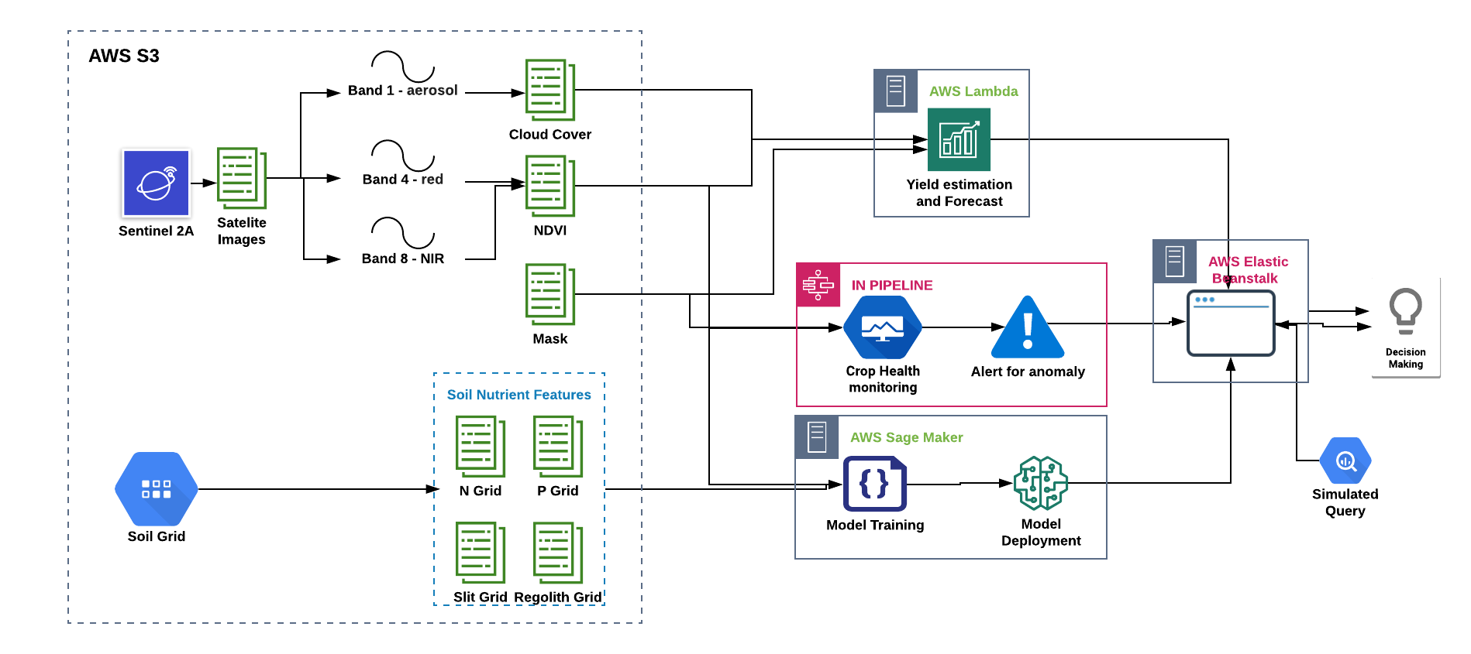
High Level System Architecture
Presented by - Jigar

Slide 4
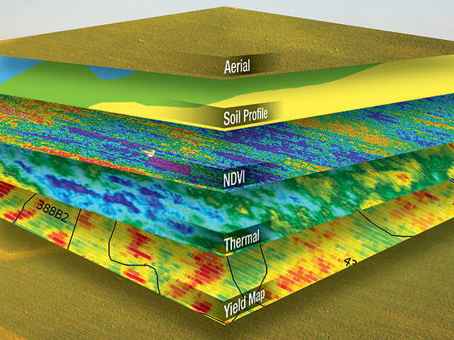
Soil Suitability Evaluation
Presented by - Vishwa
Objective is to predict inherent capability of the land for specific crop cultivation using remote sensing data to optimize time and cost.
Soil evaluation is an effective tool for land usage planning where time and resources are limited. Sugarcane can be raised on diverse kind of soil type and condition. This study can uncover potential area for farming.
With growing capabilities of sugarcane harvesting and manufacturing, this kind of analysis enables farming bodies to expand business, prepare action plan in advance and minimize manual efforts for land testing.
Training model to classify soil for sugarcane suitability
Trimming data, Initial labeling, Feature Engineering
Acquiring Soil Grid data from government bodies

Slide 5
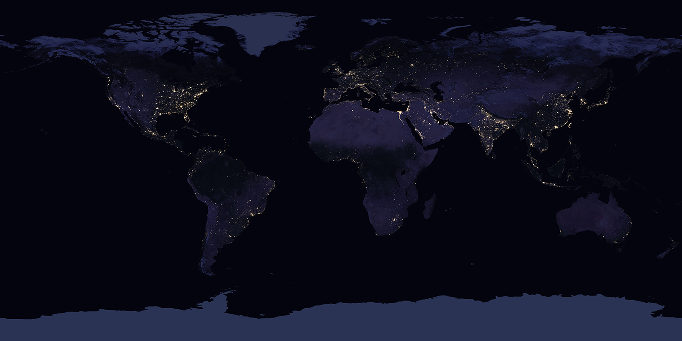
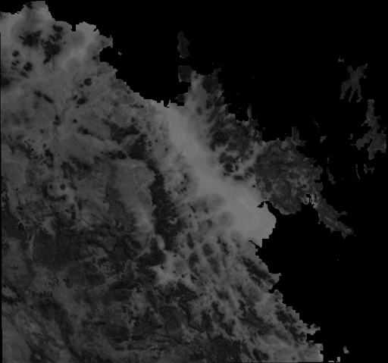
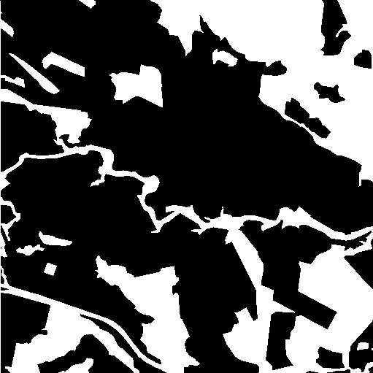
Soil Suitability Evaluation
Presented by - Vikas
Binary Classifier Model
Training Data Labels - Mask
Soil Grid Data Source: ASRIS
Data Format: GeoTiff
Narrow down search to particular region for sugarcane cultivation
Feature engineering of Soil Nutrients, Target labelling using masks
Features Soil Nutrients Grid

Slide 6
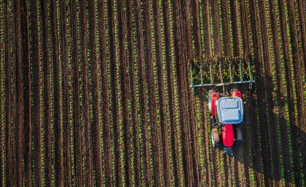
Yield Estimation and Forecasting
Presented by - Ria
Predicting the crop yield is an important aspect from the farmer’s perspective. There are various stakeholders who can utilize the yield prediction. This include farmers, banks and industry stakeholders.
Farmers get impacted majorly by the amount of yield produced each year. It helps them plan for forward selling and crop management practices.
Calculating NDVI values, removing images with high cloud cover
Based upon harvested area and crop density estimating the crop yield
Forecasting crop yield by fitting model to estimated yield

Slide 7
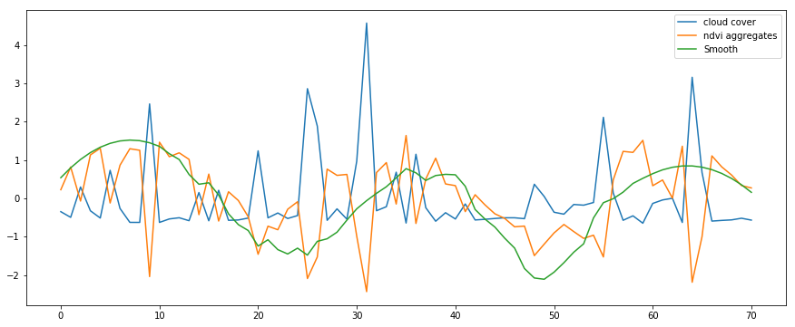
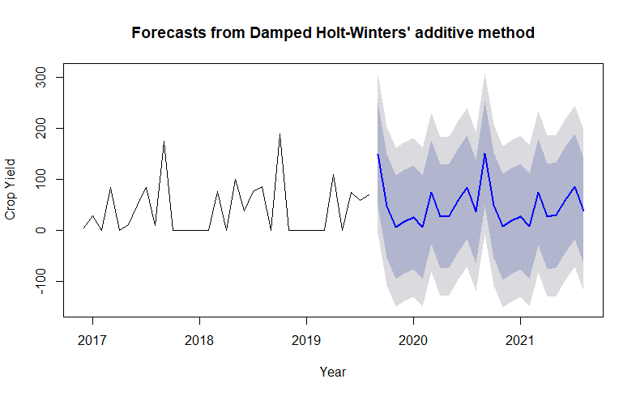
Yield Estimation and Forecasting
Presented by - Salina
Finding cloud cover using band-1 Images and filter images crossing threshold
Smoothened NDVI score using savgol transform and marking harvested area of images using NDVI.
Considering crop density and marked harvested area, estimating the crop yield of that image.
Fitting exponential smoothing holt winters’ model to forecast the crop yield

Slide 8
User Interface Design
Presented by - Sarthak

Slide 9
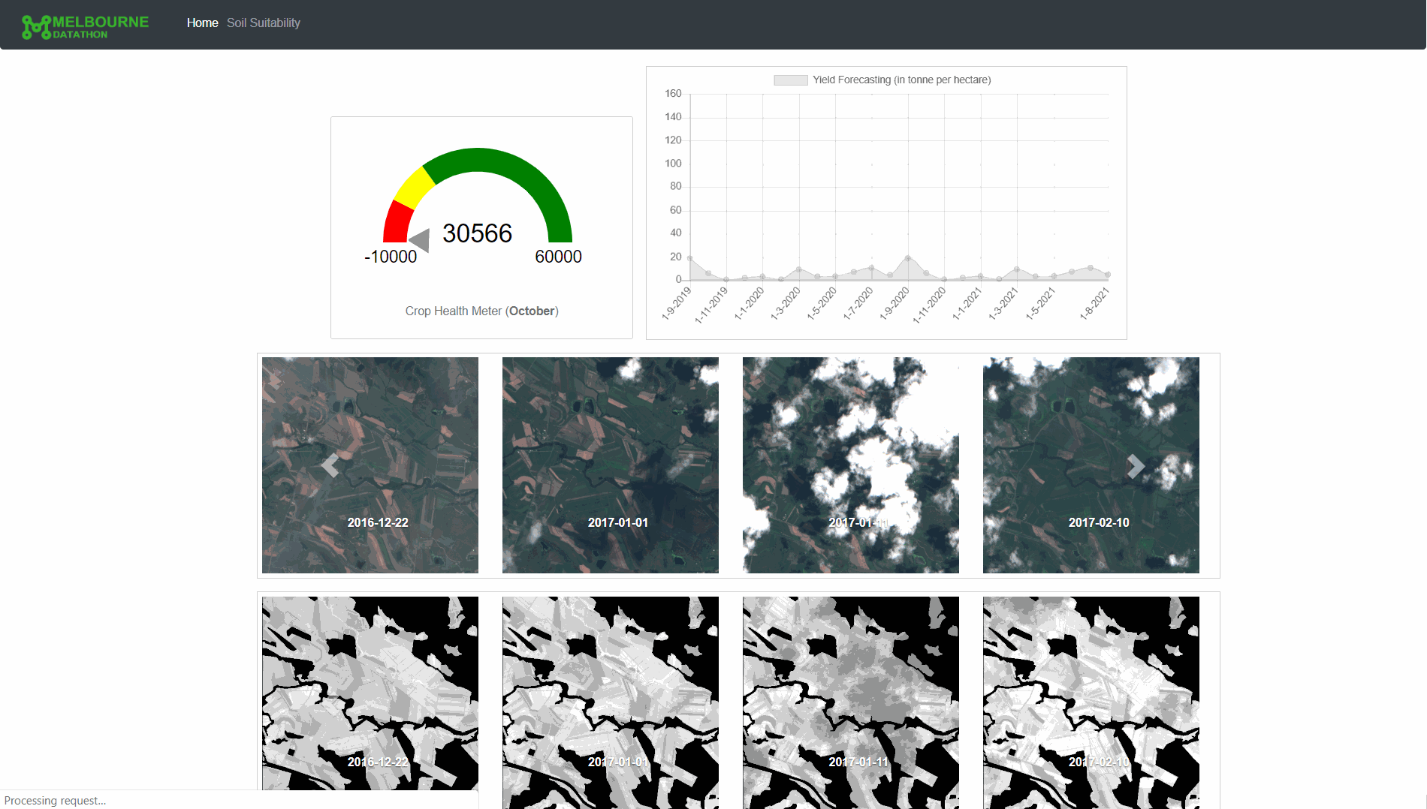

Slide 10
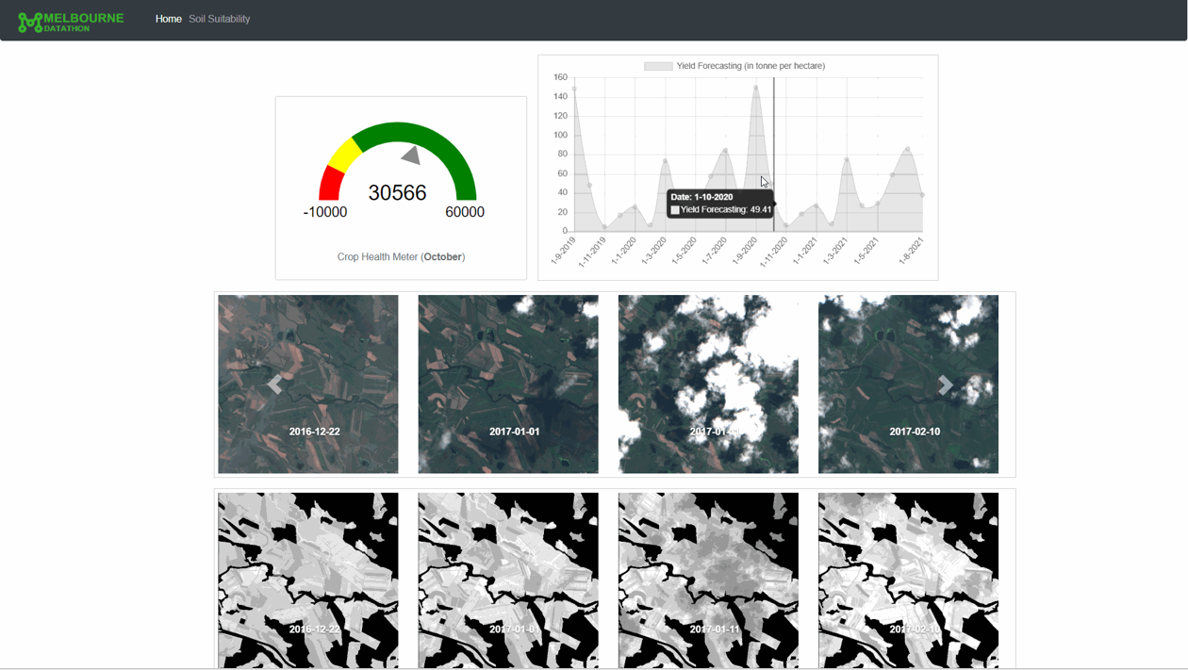

Slide 11
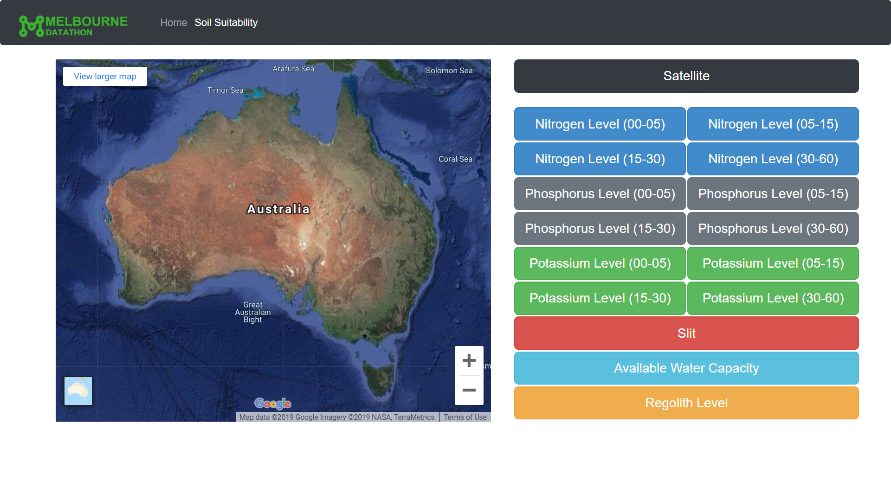

Slide 12
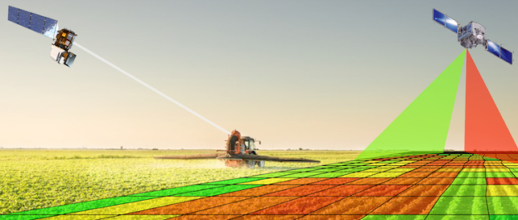
Future Work: Crop Health Monitoring
Presented by - Sarthak
Crop Health Monitoring is another important aspect for farmers
Industrial sugarcane farms generally occupy a large area of land
Manual monitoring of crop health over large area is difficult and exhaustive
Availability of high-resolution satellite imagery facilitates effective tracking of crop health
Quantify crop health using monthly average NDVI scores and current NDVI score

Slide 13
References
"ipyleaflet: Interactive maps in the Jupyter notebook — ipyleaflet documentation", Ipyleaflet.readthedocs.io, 2019. [Online]. Available: https://ipyleaflet.readthedocs.io/en/latest/. [Accessed: 11- Oct- 2019].
"Welcome to GeoPy’s documentation! — GeoPy 1.20.0 documentation", Geopy.readthedocs.io, 2019. [Online]. Available: https://geopy.readthedocs.io/en/stable/. [Accessed: 11- Oct- 2019].
S. Corlay, "Interactive GIS in Jupyter with ipyleaflet", Medium, 2019. [Online]. Available: https://blog.jupyter.org/interactive-gis-in-jupyter-with-ipyleaflet-52f9657fa7a. [Accessed: 11- Oct- 2019].
J. Ladd, J. Otis, C. Warren and S. Weingart, "Exploring and Analyzing Network Data with Python", Programminghistorian.org, 2019. [Online]. Available: https://programminghistorian.org/en/lessons/exploring-and-analyzing-network-data-with-python. [Accessed: 13- Oct- 2019].
A. Robson and M. Moshiur, "A Novel Approach for Sugarcane Yield Prediction Using Landsat Time Series Imagery: A Case Study on Bundaberg Region", in researchgate, glasgow, 2016.
The application of remote sensing techniques to sugarcane (Saccharum spp. hybrid) production: a review of the literature. (2019). International Journal of Remote Sensing, [online] p. Available at: https://www.tandfonline.com/doi/abs/10.1080/01431160701874603 [Accessed 13 Oct. 2019].
Sentinel.esa.int. (2019). Spatial - Resolutions - Sentinel-2 MSI - User Guides - Sentinel Online. [online] Available at: https://sentinel.esa.int/web/sentinel/user-guides/sentinel-2-msi/resolutions/spatial [Accessed 13 Oct. 2019].

Slide 14
Thank you
Questions?

